Slide 1
Chapter 9: Virtual Memory
Modified by maria

Slide 2
Chapter 9: Virtual Memory
Background
Demand Paging
Copy-on-Write
Page Replacement
Allocation of Frames
Thrashing
Memory-Mapped Files
Allocating Kernel Memory
Other Considerations
Operating-System Examples

Slide 3
Objectives
To describe the benefits of a virtual memory system
To explain the concepts of demand paging, page-replacement algorithms, and allocation of page frames
To discuss the principle of the working-set model
To examine the relationship between shared memory and memory-mapped files
To explore how kernel memory is managed

Slide 4
Background
Code needs to be in memory to execute, but entire program rarely used
Error code, unusual routines, large data structures
Entire program code not needed at same time
Consider ability to execute partially-loaded program
Program no longer constrained by limits of physical memory
Each program takes less memory while running -> more programs run at the same time
Increased CPU utilization and throughput
Less I/O needed to load or swap programs into memory -> each user program runs faster
Notes:
-In previous chapter, we required the whole process to be in memory.
-Removing this requirement increases the degree of multiprogramming.
-No need to keep whole process in memory as it has rarely used parts:
-Programs have code to handle errors
-Arrays, lists, symbol tables etc. may be allocated more memory than they normally use
-Certain options and features of programs rarely used e.g. the drawing toolbar on MS Word
Dynamic loading did the trick but needed extra work by programmer and other precautions.
-Even if whole program needed, may not be needed at the same time.

Slide 5
Background (Cont.)
Virtual memory – separation of user logical memory from physical memory
Only part of the program needs to be in memory for execution
Logical address space can therefore be much larger than physical address space
Allows address spaces to be shared by several processes
Allows for more efficient process creation
More programs running concurrently
Less I/O needed to load or swap processes

Slide 6
Background (Cont.)
Virtual address space – logical view of how process is stored in memory
Usually start at address 0, contiguous addresses until end of space
Meanwhile, physical memory organized in page frames
MMU must map logical to physical
Virtual memory can be implemented via:
Demand paging
Demand segmentation

Slide 7
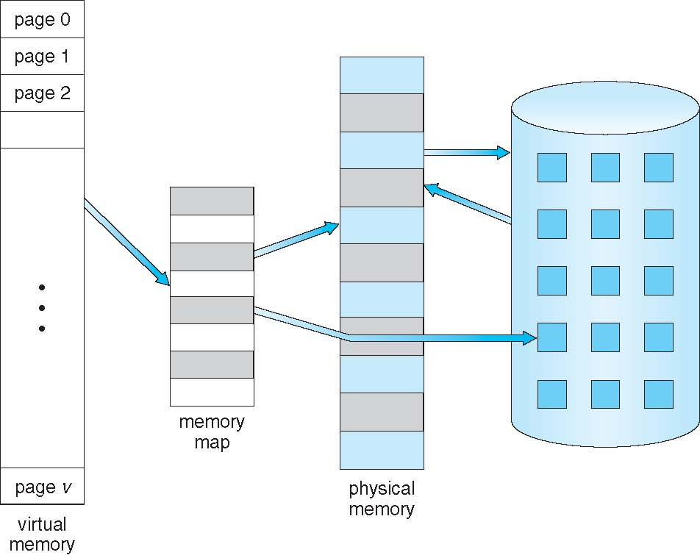
Virtual Memory That is Larger Than Physical Memory

Slide 8
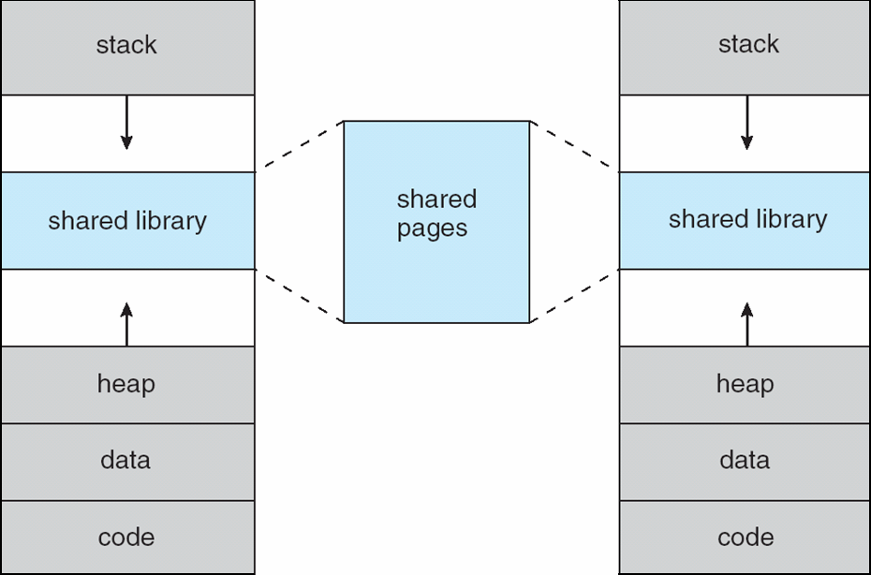
Shared Library Using Virtual Memory
Notes:
-As studied in Ch.8, virtual memory allows sharing reentrant code. Shared pages thought to be in each sharing process’s virtual address space, but physically one copy.
-Processes can share memory to communicate.

Slide 9
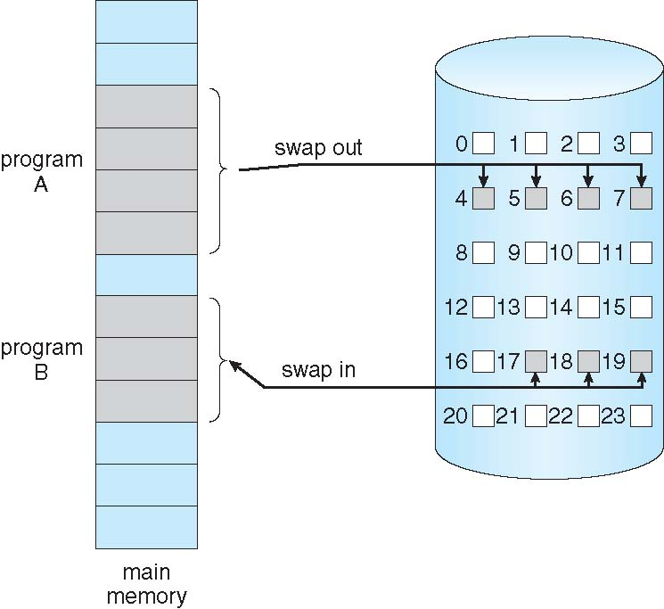
Demand Paging
Could bring entire process into memory at load time
Or bring a page into memory only when it is needed
Less I/O needed
Less memory needed
Faster response
More users
Similar to paging system with swapping (diagram on right)
Page is needed ⇒ reference to it
invalid reference ⇒ abort
not-in-memory ⇒ bring to memory
Lazy swapper – never swaps a page into memory unless page will be needed
Swapper that deals with pages is a pager
Notes:
-Demand Paging is a method of implementing Virtual Memory.
-Faster response because more programs/users in memory at once and lesser context switch time too due to less eviction/admission of pages.
-A Swapper manipulates entire processes, whereas a Pager only deals with individual pages of a process. Hence, ‘pager’ is the technically correct term now.
-Can allocate a swap space on disk which has each process’s image (whole or part) in contiguous pages; just add disk offset to virtual address to get to page on disk. Can also be non-contiguous on disk. Then mapping needed on the fly.

Slide 10
Basic Concepts
With swapping, pager guesses which pages will be actually used of a process that is to be swapped in before it is swapped out again
Pager brings in only those guessed pages into memory
How to determine that set of pages?
Need new MMU functionality to implement demand paging
If pages needed are already memory resident
No difference from non demand-paging
If page needed and not memory resident
Need to detect and load the page into memory from storage

Slide 11
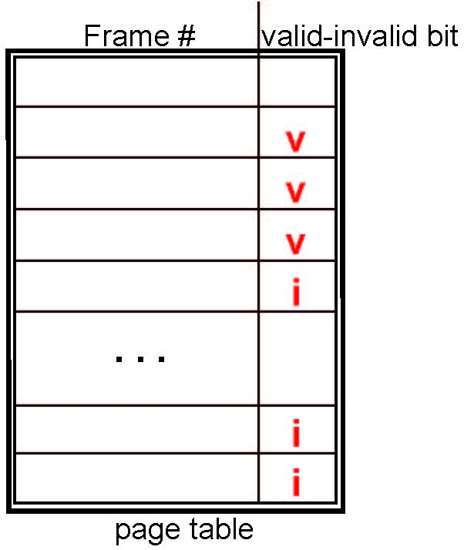
Valid-Invalid Bit
With each page table entry a valid–invalid bit is associated (v ⇒ in-memory – memory resident, i ⇒ not-in-memory)
Initially valid–invalid bit is set to i on all entries
Example of a page table snapshot:
During MMU address translation, if valid–invalid bit in page table entry is i ⇒ page fault
Notes:
-Page numbers are implicit in the table above as they are sequential in ascending order anyway.
-Same scheme as in Ch8. But this time, invalid means two things: either page not in memory, or illegal memory reference.
-Instead of ‘i’, can also store the address of page on disk.

Slide 12
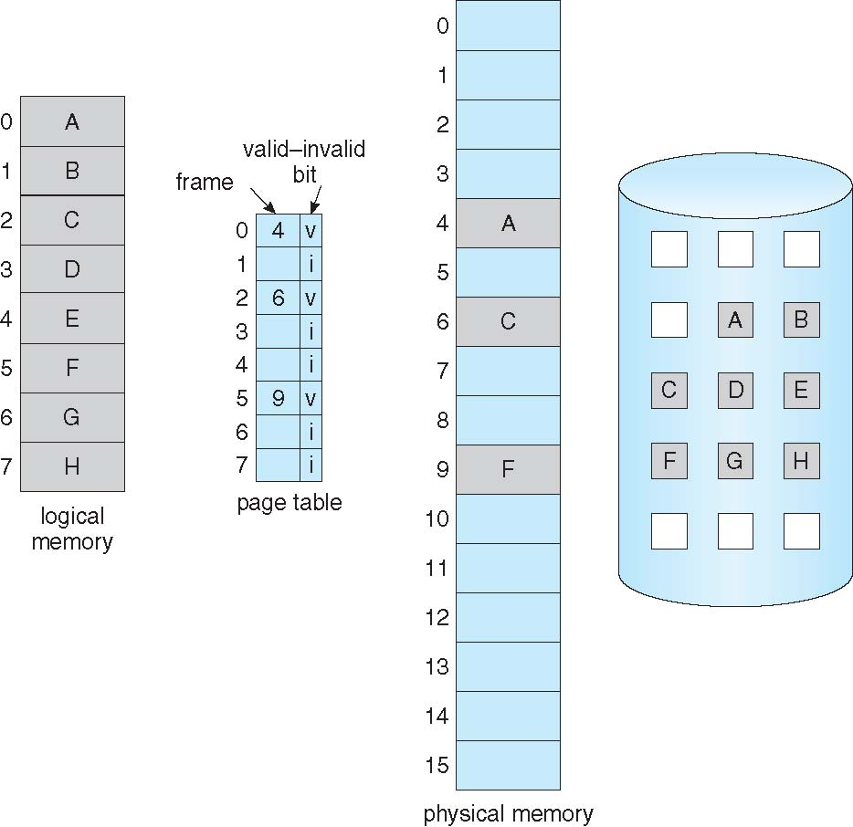
Page Table When Some Pages Are Not in Main Memory
Notes:
-If pages to be brought in guessed accurately, invalid pages have no effect on execution.
-High-speed disk used as ‘swap device’. The section of disk used for swapping is called ‘swap space‘. Subject of Ch12.

Slide 13
Page Fault
If there is a reference to a page, first reference to that page will trap to operating system:
page fault
Operating system looks at another table to decide:
Invalid reference ⇒ abort
Just not in memory
Find free frame
Swap page into frame via scheduled disk operation
Reset tables to indicate page now in memory Set validation bit = v
Restart the instruction that caused the page fault
Notes:
-This ‘another table’ is kept usually in PCB for each process.
-CPU can be allocated to another process, while this process waiting for disk-read into memory. Also, have to wait for disk to be free for a read.

Slide 14
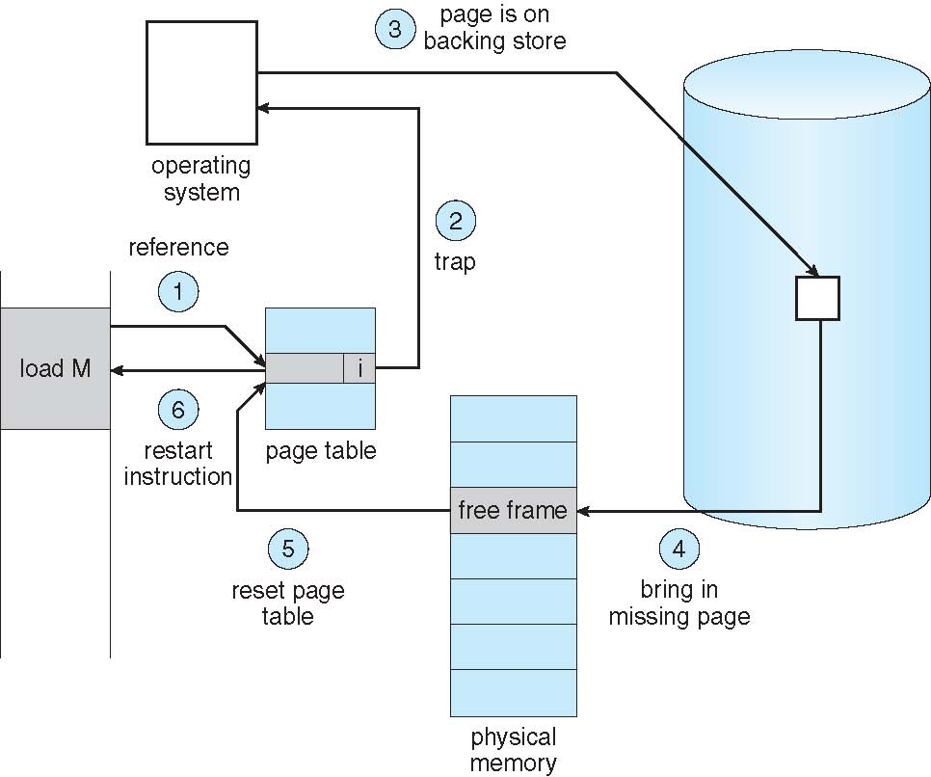
Steps in Handling a Page Fault

Slide 15
Aspects of Demand Paging
Extreme case – start process with no pages in memory
OS sets instruction pointer to first instruction of process, non-memory-resident -> page fault
And for every other process pages on first access
Pure demand paging
Actually, a given instruction could access multiple pages -> multiple page faults
Consider fetch and decode of instruction which adds 2 numbers from memory and stores result back to memory
Hardware support needed for demand paging
Page table with valid / invalid bit
Secondary memory
Instruction restart

Slide 16
Performance of Demand Paging (Cont.)
Three major activities
Service the interrupt – careful coding means just several hundred instructions needed (microseconds)
Read the page – lots of time (milliseconds)
Restart the process – again just a small amount of time (microseconds)
Page Fault Rate 0 ≤ p ≤ 1
if p = 0 no page faults
if p = 1, every reference is a fault
Effective Access Time (EAT)
EAT = (1 – p) x memory access
+ p (page fault overhead)
Notes:
-Time to access memory.
-Page fault overhead includes accessing memory again after restarting.

Slide 17
Demand Paging Example
Memory access time = 200 nanoseconds
Average page-fault service time = 8 milliseconds
EAT = (1 – p) x 200 + p (8 milliseconds)
= (1 – p) x 200 + p x 8,000,000
-One access out of 1000 is page fault, then p=1/1000 i.e. .001
Notes:
-One access out of 1000 is page fault, then p=1/1000 i.e. .001
EAT = 200 + 7999800x0.001 = 8199.8 nanoseconds
Without this page fault, memory access time was 200ns.
8199.8/200 is 40.999
-Important to keep page faults low to keep slowdown to a minimum.
[milli is 10^-3, nano is 10^-9, i.e. milli is 1 million times nano]

Slide 18
What Happens if There is no Free Frame?
Used up by process pages
Also in demand from the kernel, I/O buffers, etc
How much to allocate to each?
Page replacement – find some page in memory, but not really in use, page it out
Algorithm – terminate? swap out? replace the page?
Performance – want an algorithm which will result in minimum number of page faults
Same page may be brought into memory several times
Notes:
-The operating system has several options at this point. It could terminate the user process. However, demand paging is the operating system’s attempt to improve the computer system’s utilization and throughput. Users should not be aware that their processes are running on a paged system—paging should be logically transparent to the user. So this option is not the best choice.
The operating system could instead swap out a process, freeing all its frames and reducing the level of multiprogramming. This option is a good one
in certain circumstances, and we consider it further in Section 9.6.
Here, we discuss the most common solution: page replacement.

Slide 19
Page Replacement
Prevent over-allocation of memory by modifying page-fault service routine to include page replacement
’Over-allocation’ of memory means increasing the degree of multiprogramming. This can result in page faults and the need for page replacement as no free frames available.
Use modify (dirty) bit to reduce overhead of page transfers – only modified pages are written to disk
Page replacement completes separation between logical memory and physical memory – large virtual memory can be provided on a smaller physical memory
Notes:
-’Over-allocation’ of memory means increasing the degree of multiprogramming. This can result in page faults and the need for page replacement as no free frames available.
-Dirty bit: a bit in hardware associated with each frame which is set if the page is modified in memory. If that page needs to be evicted, we only write it back to disk if it has been modified in memory. Dirty bit scheme reduces I/O time to half. Same holds for read-only pages.

Slide 20
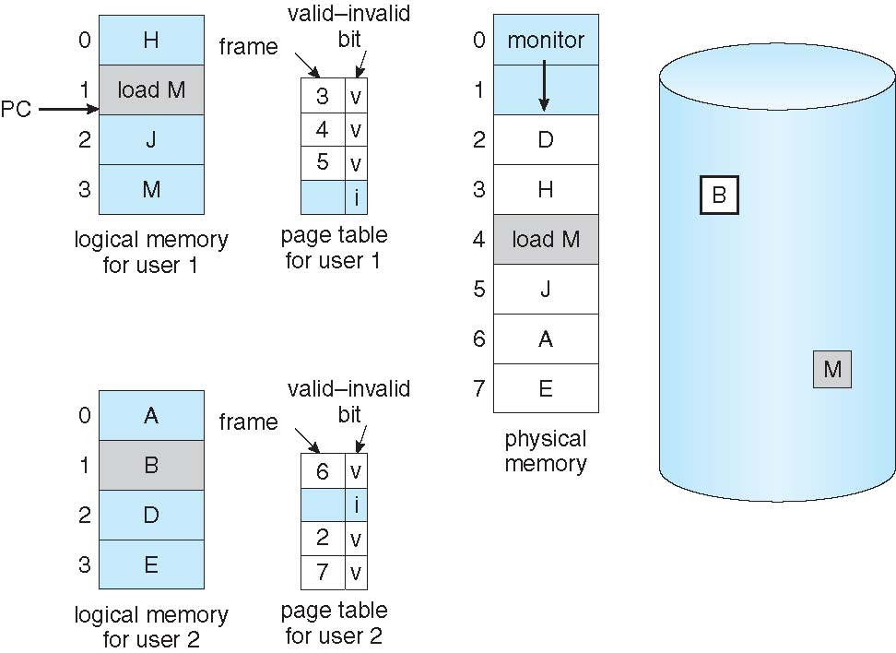
Need For Page Replacement
Notes:
-load M refers to M, which is not in memory.
-No free frame available to bring in M or B.

Slide 21
Basic Page Replacement
Find the location of the desired page on disk
Find a free frame: - If there is a free frame, use it - If there is no free frame, use a page replacement algorithm to select a victim frame - Write victim frame to disk if dirty
Bring the desired page into the (newly) free frame; update the page and frame tables
Continue the process by restarting the instruction that caused the trap
Note now potentially 2 page transfers for page fault – increasing EAT

Slide 22
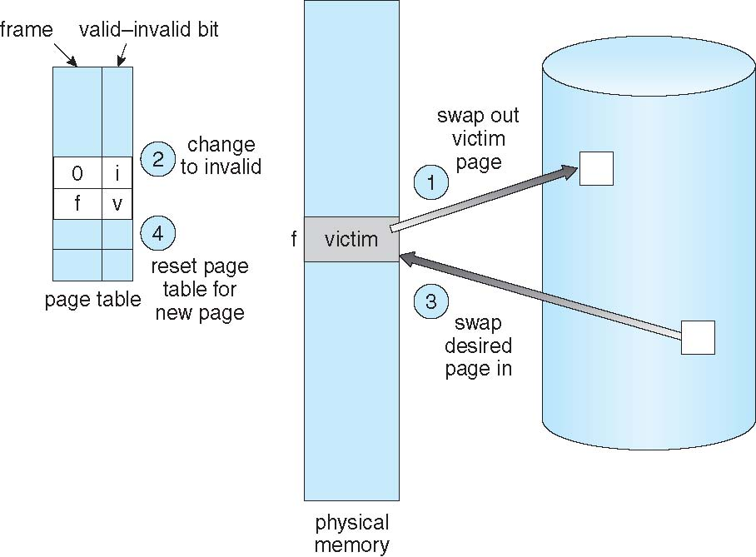
Page Replacement
Notes:
-Now frame f will be allocated to a new page, so it will now appear in the page table against the new page that it carries. The old, evicted page now has a 0 written in front of it as frame number and the invalid bit is also set for it.

Slide 23
Page and Frame Replacement Algorithms
Frame-allocation algorithm determines
How many frames to give each process
Which frames to replace
Page-replacement algorithm
Want lowest page-fault rate on both first access and re-access
Evaluate algorithm by running it on a particular string of memory references (reference string) and computing the number of page faults on that string
String is just page numbers, not full addresses
Repeated access to the same page does not cause a page fault
Results depend on number of frames available
In all our examples, the reference string of referenced page numbers is
7,0,1,2,0,3,0,4,2,3,0,3,0,3,2,1,2,0,1,7,0,1
Notes:
-Each OS has its own page-replacement scheme.
-If a page is immediately referenced again, there is no page fault. Read book for obtaining reference string from a sequence of generated addresses; only changed page matters.
-The numbers in the reference string are page numbers.

Slide 24
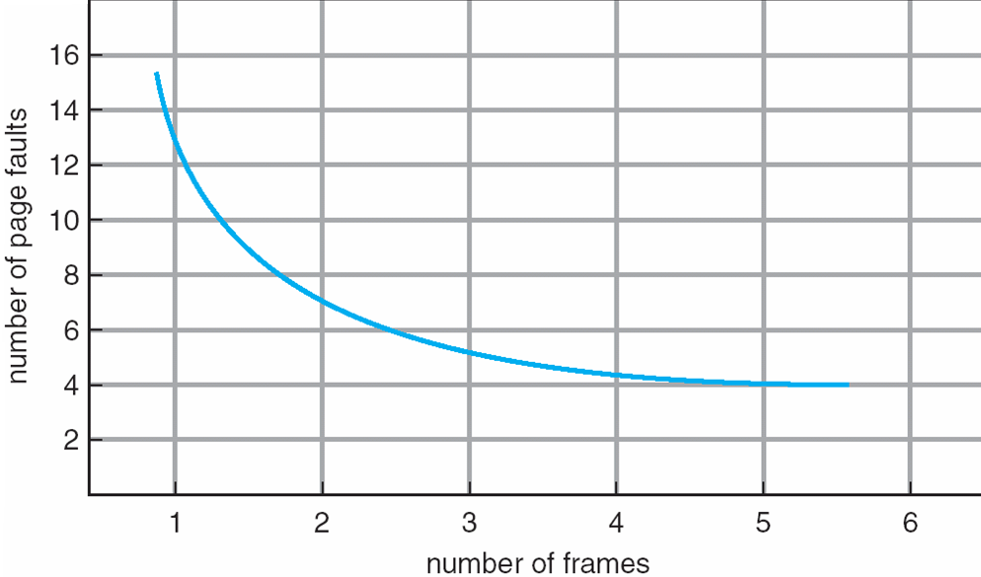
Graph of Page Faults Versus The Number of Frames
Notes:
-More memory means less page faults. Shows average number of frames.

Slide 25
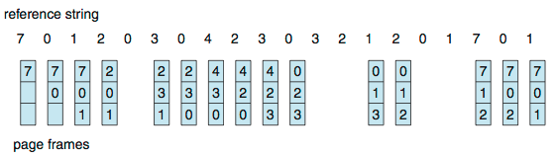
First-In-First-Out (FIFO) Algorithm
Reference string: 7,0,1,2,0,3,0,4,2,3,0,3,0,3,2,1,2,0,1,7,0,1
3 frames (3 pages can be in memory at a time per process)
Can vary by reference string: consider 1,2,3,4,1,2,5,1,2,3,4,5
Adding more frames can cause more page faults!
Belady’s Anomaly
15 page faults
Notes:
-We can create a queue of pages in memory and replace the page at head (oldest in memory) and insert new page coming into memory at tail (no need to record times for pages then).
-Belady discovered this in 1969 for FIFO. Till then, FIFO was deemed acceptable.
http://portal.acm.org/citation.cfm?doid=363011.363155
Read the abstract of this paper:
http://iisit.org/Vol6/IISITv6p825-836McMaster617.pdf

Slide 26
FIFO Illustrating Belady’s Anomaly
Notes:
-Graph for reference string 1,2,3,4,1,2,5,1,2,3,4,5

Slide 27
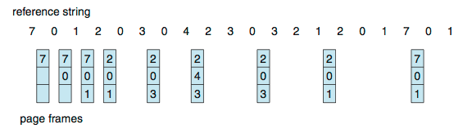
Optimal Algorithm
Replace page that will not be used for longest period of time
How do you know this?
Can’t read the future
Used for measuring how well your algorithm performs
Notes:
-Guarantees lowest possible page fault rate for a fixed number of frames, and no Belady’s Anomaly.
-FIFO looks at oldest page in time. OPT looks at the time when page will be used.
-Belady’s anomaly led to research to find the best algo.
-This best one called OPT or MIN.
-Replace page with largest forward distance from present.
-How to know the future references in advance?
Need to know all reference strings for all running threads in all processes. Same problem as in SJF CPU-scheduling algo. So use only for comparison (using known reference strings).
-Can choose FIFO if more than one page with maximum forward distance e.g. while allocating frame for page 1 to page 4 at the end.

Slide 28
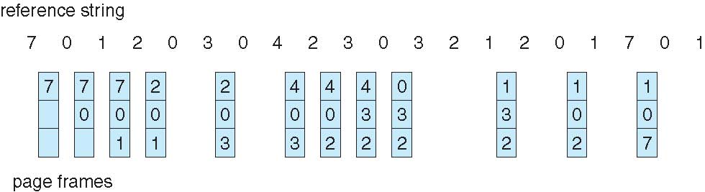
Least Recently Used (LRU) Algorithm
Use past knowledge rather than future
Replace page that has not been used in the most amount of time
Associate time of last use with each page
12 faults – better than FIFO but worse than OPT
Generally good algorithm and frequently used
But how to implement?
Notes:
-This is different from FIFO. E.g. look at the behaviour when page 3 is to be accommodated (the 5th page fault in the figure). FIFO would have replaced page 0 but it isn’t in LRU because page 0 was referenced just one reference ago and this makes page 1 the oldest referenced page, and hence page 1 is replaced with page 3.

Slide 29
LRU Algorithm (Cont.)
Counter implementation
Every page entry has a counter; every time page is referenced through this entry, copy the clock into the counter
When a page needs to be changed, look at the counters to find smallest value
Stack implementation
Page referenced:
move it to the top
No search for replacement; bottom of stack is the LRU page
LRU and OPT don’t have Belady’s Anomaly
Notes:
-Both OPT and LRU belong to the class of algorithms called ‘stack algorithms’ for which it can be shown that the set of pages in memory for n frames is always a subset of pages in memory for n +1 frames. Read book and ponder the point that how this ensures that there won’t be Belady’s anomaly.

Slide 30
Use Of A Stack to Record Most Recent Page References

Slide 31
LRU Approximation Algorithms
LRU needs special hardware and still slow
Reference bit
With each page associate a bit, initially = 0
When page is referenced bit set to 1
Replace any with reference bit = 0 (if one exists)
We do not know the order, however
Second-chance algorithm
Generally FIFO, plus hardware-provided reference bit
Clock replacement
If page to be replaced has
Reference bit = 0 -> replace it
reference bit = 1 then:
set reference bit 0, leave page in memory
replace next page, subject to same rules
Notes:
-Much hardware support needed for either of the exact implementations of LRU (counter or stack); otherwise slows system down due to amount of work done each time.
-Few OSes provide this support. Instead, some provide a reference bit.
-Read in book Additional-Reference-Bits Algorithm, in which a byte can be used for each page as a counter and reference bit is shifted into the highest order bit after fixed intervals and the rest shifted right. So 1’s will denote references to the page and the page with lowest numerical value counter is the LRU page.

Slide 32
Second-Chance (clock) Page-Replacement Algorithm
Notes:
-Implemented as a circular queue.
-Pointer (clock hand) points to the next potential victim and advances.
-When a page is given second chance, it’s arrival time is also reset to the current time (so that FIFO is maintained).
-Degenerates to (reduces to) FIFO when?
http://en.wikipedia.org/wiki/Page_replacement_algorithm#Second-chance

Slide 33
Counting Algorithms
Keep a counter of the number of references that have been made to each page
Not common
Lease Frequently Used (LFU) Algorithm: replaces page with smallest count
Most Frequently Used (MFU) Algorithm: based on the argument that the page with the smallest count was probably just brought in and has yet to be used
Notes:
-LFU is different from LRU.
Omit articles Page Buffering Algorithms and Applications & Page Replacement in textbook.

Slide 34
Allocation of Frames
Each process needs minimum number of frames
Maximum of course is total frames in the system
Two major allocation schemes
fixed allocation
priority allocation
Many variations

Slide 35
Fixed Allocation
Equal allocation – For example, if there are 100 frames (after allocating frames for the OS) and 5 processes, give each process 20 frames
Keep some as free frame buffer pool
Proportional allocation – Allocate according to the size of process
Dynamic as degree of multiprogramming, process sizes change

Slide 36
Priority Allocation
Use a proportional allocation scheme using priorities rather than size
If process P_{i} generates a page fault,
select for replacement one of its frames
select for replacement a frame from a process with lower priority number

Slide 37
Global vs. Local Allocation
Global replacement – process selects a replacement frame from the set of all frames; one process can take a frame from another
But greater throughput so more common
Local replacement – each process selects from only its own set of allocated frames
More consistent per-process performance
But possibly underutilized memory

Slide 38
Thrashing
If a process does not have “enough” pages, the page-fault rate is very high
Page fault to get page
Replace existing frame
But quickly need replaced frame back
This leads to:
Low CPU utilization
Operating system thinking that it needs to increase the degree of multiprogramming
Another process added to the system
Thrashing ≡ a process is busy swapping pages in and out
Notes:
-If a process does not have enough frames to support active pages, it has to swap out some page. But as it didn’t have enough frames, this
swapped out page was also in active use and will be needed again immediately. Hence process will page fault again and again and again...
-In global replacement, all processes get robbed of active pages and start thrashing. Ready queue empties and swap-device queue fills up.

Slide 39
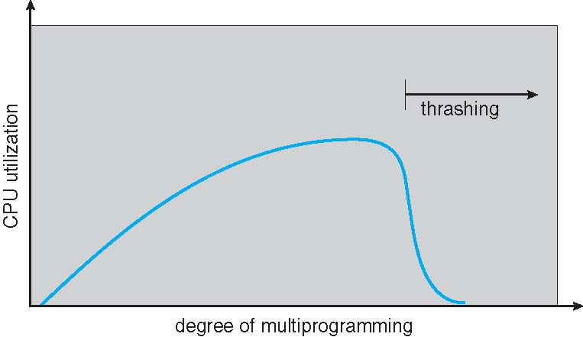
Thrashing (Cont.)
Notes:
-We must ‘decrease’ the degree of multiprogramming rather than increase it when CPU-utilisation starts to fall sharply.

Slide 40
Reducing Thrashing
When thrashing occurs, use local or priority replacement algorithm
Must provide enough frames to a process
But how many are “enough”?
One technique to provide enough frames is the working-set technique (discussed later) that uses the locality model of process execution
Notes:
-Local replacement ensures that pages of other processes not taken away by the thrashing process.

Slide 41
Demand Paging and Thrashing
Why does demand paging work? Locality model
Temporal locality If at one point in time a particular memory location is referenced, then it is likely that the same location will be referenced again in the near future.
Spatial localityIf a particular memory location is referenced at a particular time, then it is likely that nearby memory locations will be referenced in the near future.
Notes:
-A function defines one locality with its own sets of variables and instructions. We exit this locality when we exit the function.

Slide 42
Locality of Reference
Temporal and spatial locality in storage
Temporal: storage locations referenced recently are referenced again
Looping
Subroutines
Variables used for counting and totaling
Spatial: storage references usually clustered; hence, nearby ones referenced more
Array traversals
Sequential code execution
Programmers’ tendency to place related variable definitions near one another
Notes:
-Weather example: if it’s sunny at 1pm, it’s likely to be sunny at 2pm (temporal locality);
if it’s sunny in Mughalpura it’s likely to be sunny on Mall Road (spatial locality).

Slide 43
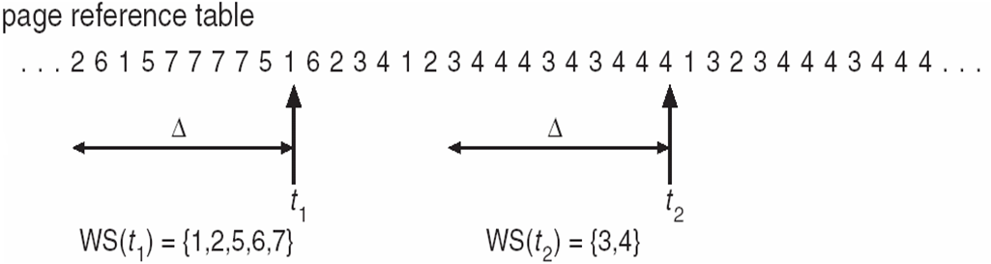
Working-Set Model
Informal definition: the collection of pages a process is using actively, and which must thus be memory-resident to prevent this process from thrashing.
Δ ≡ working-set window ≡ a fixed number of page references Example: 10,000 instructions
WSS_{i} (working set of Process P_{i}) = total number of pages referenced in the most recent Δ (varies in time)
A page will drop out of the working set if it is not referenced in the last ∆ (delta) time units.
Have to choose delta well.
∆ here is 10 memory references.
D = Σ WSS_{i} ≡ total demand frames
Approximation of locality
if D > m ⇒ Thrashing
Policy if D > m, then suspend or swap out one of the processes
Notes:
-A page will drop out of the working set if it is not referenced in the last ∆ (delta) time units.
-Have to choose delta well.
-∆ here is 10 memory references.

Slide 44
Windows
Uses demand paging with clustering. Clustering brings in pages surrounding the faulting page
Processes are assigned working set minimum and working set maximum
Working set minimum is the minimum number of pages the process is guaranteed to have in memory
A process may be assigned as many pages up to its working set maximum
Notes:
-Min. and max. are usually 50 and 345 pages respectively.
-If process page faults and max. is reached, local page-replacement done.

Slide 45
End of Chapter 9

